Slide 1

Course : T1214 - Object Oriented Game Programming
Year : 2013
Design Pattern in Game Programming Week 11
Notes:
1

Slide 2
Learning Outcomes
LO 3 : Design a program architecture using features of OOP
Bina Nusantara

Slide 3
Outline Materi
What a design pattern is
Why use design pattern
Common game programming design pattern
Bina Nusantara

Slide 4
What is Design Pattern?
Design patterns (DPs) are proven solutions to well-established software engineering problems.
Design patterns are generalized solutions to generalized problems.
As computer science has evolved, some problems have become classic and tend to appear frequently in many different contexts
Bina Nusantara

Slide 5
Why Use Design Patterns?
because these solutions have existed for a relatively long time and many experts have used them, they're likely better than any solution you could come up with on your own
And even if you did come up with a solution on your own, it's likely already a design pattern in some way
Knowledge of contextually pertinent design patterns helps you to make good architecture and design decisions
Bina Nusantara

Slide 6
Singleton
A singleton is a global object for which only one instance exists in the whole application
Most applications, and definitely all games, need global objects that must be visible from many different classes and scopes
Bina Nusantara

Slide 7
Singleton
Why we use it?
It doesn’t create the instance if no one uses it. Saving memory and CPU cycles is always good.
It’s initialized at runtime. A common alternative to Singleton is a class with static member variables but there’s one limitation static members have: automatic initialization.
You can subclass the singleton. This is a powerful but often overlooked capability. Cross platform !!!
Bina Nusantara

Slide 8

Singleton Example
Bina Nusantara

Slide 9
Singleton
Why not using it?
They make it harder to reason about code. Say we’re tracking down a bug in a function someone else wrote.
They encourage coupling.
They aren’t concurrency-friendly. The days of games running on a simple single-core CPU are pretty much over.
Bina Nusantara

Slide 10
Singleton Better Example
A texture manager
the joystick controller object
Bina Nusantara

Slide 11
Factory
Modern applications need to create and dispose of objects continually
Whether objects are text blocks in a word processor or enemies in a hack-and-slash game, a significant portion of your program is surely devoted to creating them on demand
The factory pattern centralizes the object creation and destruction, thus providing a universal, rock-solid method for handling objects
Bina Nusantara

Slide 12
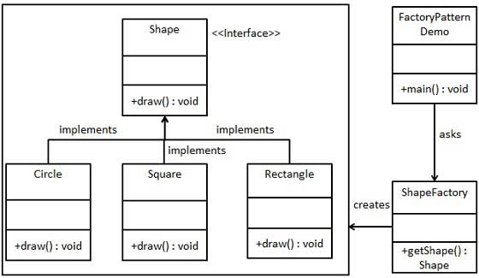
Factory
Bina Nusantara

Slide 13
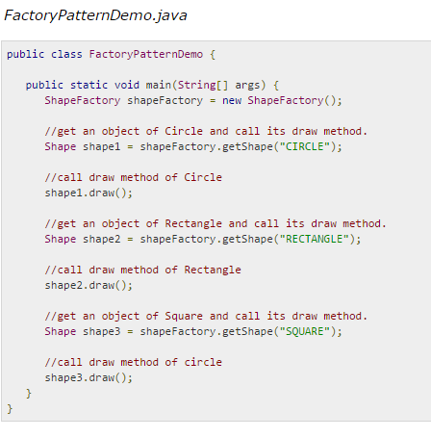
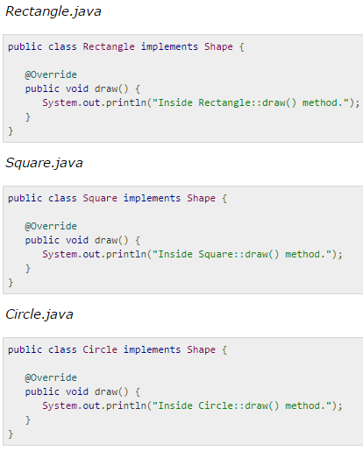
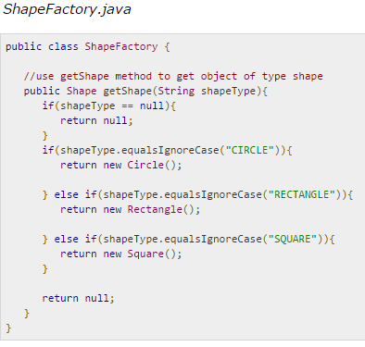
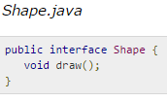
Factory
Bina Nusantara

Slide 14
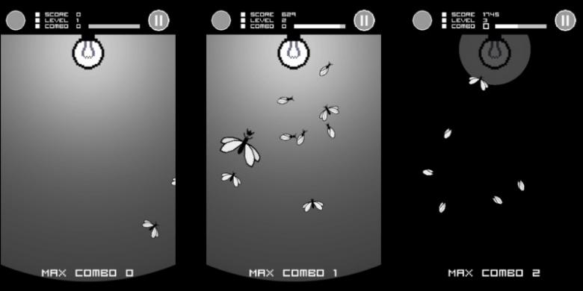
Factory Example
Bina Nusantara

Slide 15
Observer
The object in question maintains a list of other objects that are interested in its state and notifies these listening objects of a change in its state
This pattern helps you avoid the problem of event notification in your game
Since games are user-interaction driven, objects can change state at almost any time
When an object changes state oftentimes that object needs to be animated or have other objects change their state with respect to the new state
Bina Nusantara

Slide 16
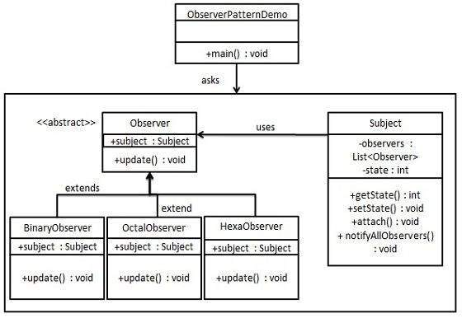
Observer
Bina Nusantara

Slide 17
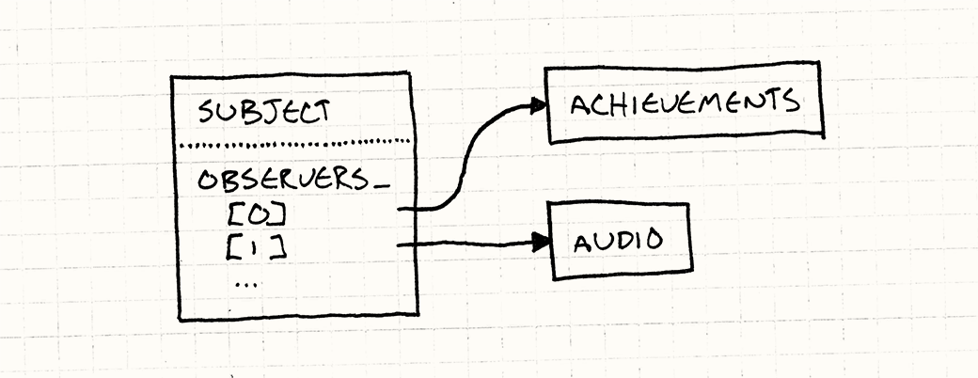
Observer Example
Bina Nusantara

Slide 18
Strategy
Sometimes you will need to create objects whose behavior can be changed dynamically
A quick and dirty solution would be to store a state variable and use it to drive a switch construct that selects the proper routine according to the desired behavior
Another solution is to subclass the object, so each one of the derived objects implements one of the algorithms. This solution is simply too complex in practical terms
Strategy pattern’s goal is to separate the class definition from one (or several) of its member algorithms, so these algorithms can be interchanged at runtime dynamically in an elegant way
Bina Nusantara

Slide 19
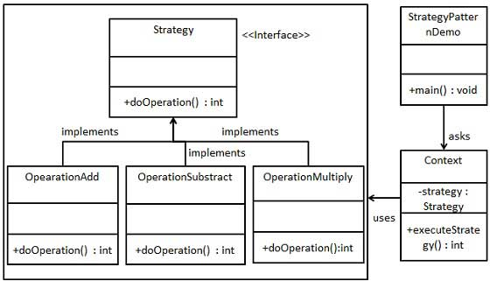
Strategy
Bina Nusantara

Slide 20
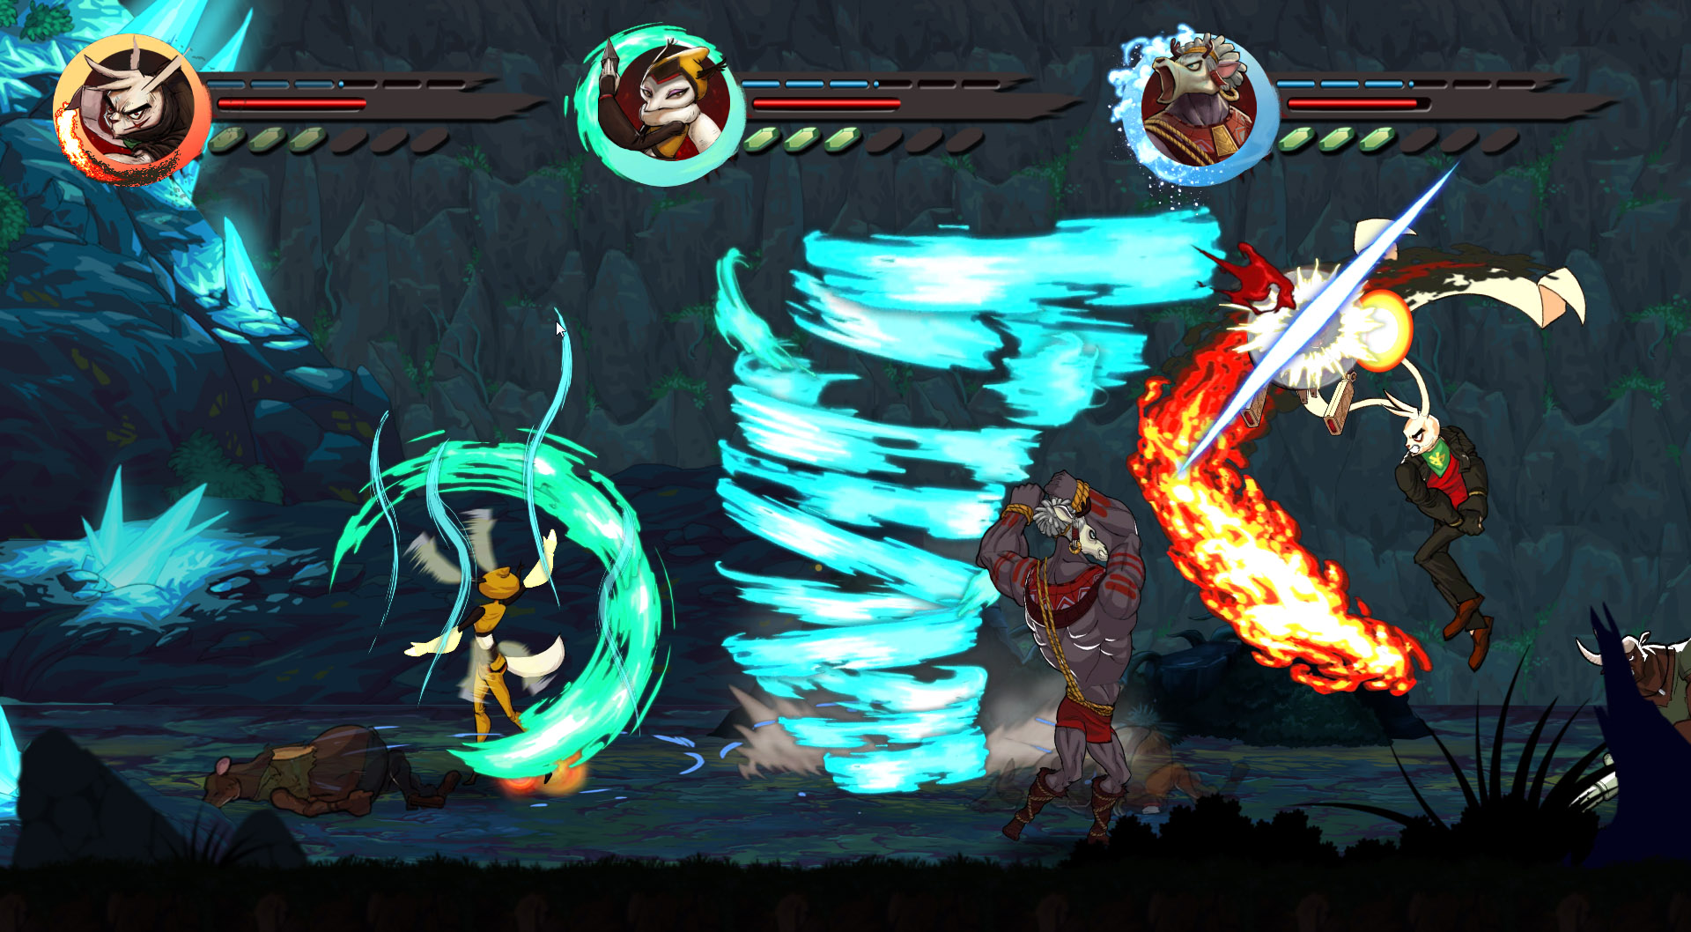
Strategy Example

Slide 21
Composite
Many types of applications, and games in particular, need to hold heterogeneous collections of data together for different reasons
A game level can have sublevels (which in turn can have sublevels), potions, enemies (which can be composed, for example, as in a horse and rider approach), objects, and so on
The overall data structure can be best described as a part-whole hierarchy with each element being either a primitive or a composite
Most programming languages only support homogeneous arrays, so a higher-abstraction solution is needed
This is what the composite DP is all about: creating part-whole heterogeneous hierarchies where we can access primitives and composite objects using a standard interface
Bina Nusantara

Slide 22
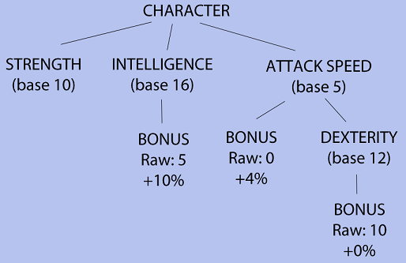
Composite
Bina Nusantara

Slide 23
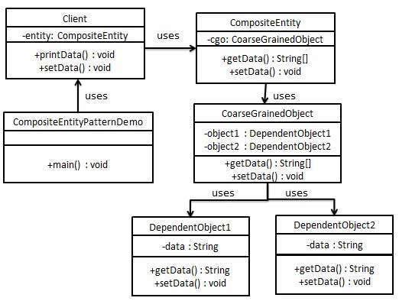
Composite
Bina Nusantara

Slide 24
Flyweight
extremely useful when we need to have large collections of objects that are fundamentally the same except for a few parameters
In this case, we do not want to overpopulate our memory with lots of objects that are mostly identical, but instead we want to use system resources efficiently while keeping a uniform access interface
A simple and very game-oriented example is the units in a real-time strategy game. All infantry soldiers are virtually the same except for two parameters: the position and the life level
the flyweight pattern suggests dividing the object into two separate classes
the actual flyweight, which is the core object and is shared among all instances
external objects that will use the flyweights, passing the extrinsic (thus, state dependent) information as a parameter. These concrete objects contain state information, such as the position and life level of our strategy game soldiers.
Bina Nusantara

Slide 25
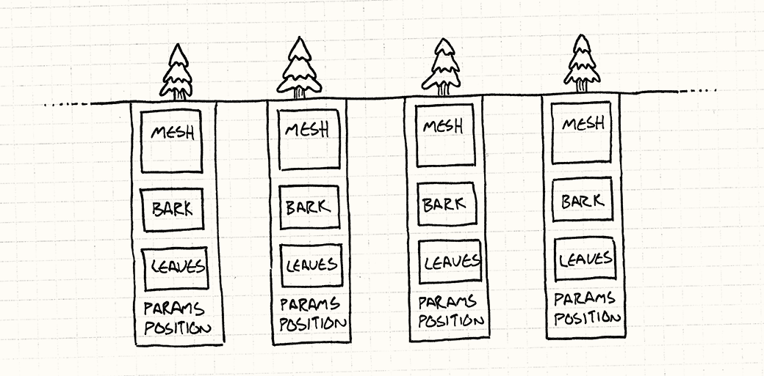
Flyweight
Bina Nusantara

Slide 26
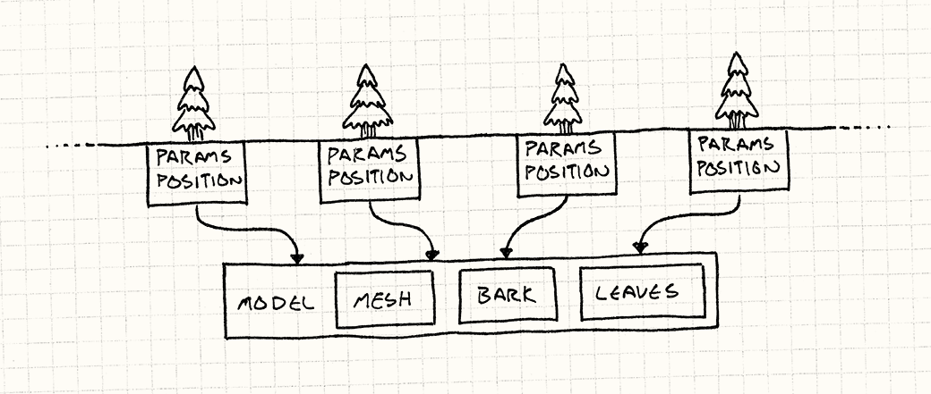
Flyweight
Bina Nusantara

Slide 27
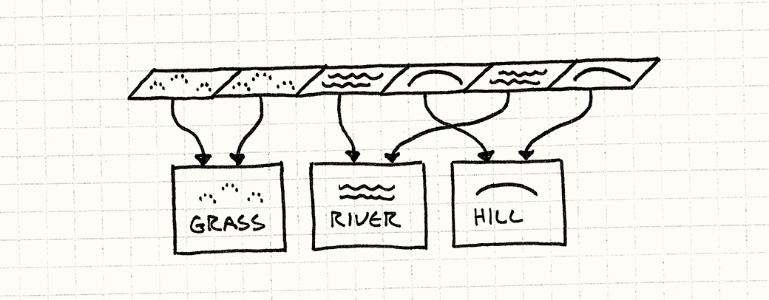
Flyweight
Bina Nusantara

Slide 28
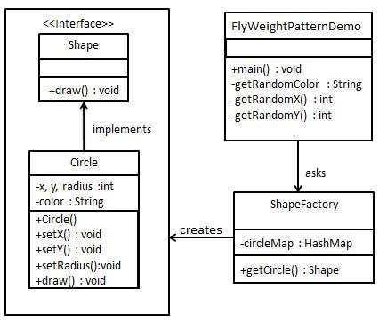
Flyweight
Bina Nusantara

Slide 29
Assignment
Design 2 games that will implement the following design pattern:
First game will implement singleton, flyweight and observer.
Second game will implement flyweight, composite and strategy.
Create the mockup of the game and explanation on what the design pattern will be implemented.

Slide 30
- End -
Q & A
Bina Nusantara

